Slide 1
UNIT I INTRODUCTION TO ALGORITHM DESIGN

Slide 2
Asymptotic Notations
Main idea of asymptotic analysis
To have a measure of efficiency of algorithms
That doesn’t depend on machine specific constants,
That doesn’t require algorithms to be implemented
Time taken by programs to be compared.
Asymptotic notations
Asymptotic notations are mathematical tools to represent time complexity of algorithms for asymptotic analysis.

Slide 3
Asymptotic Analysis
Asymptotic analysis refers to computing the running time of any operation in mathematical units of computation.
Ο Notation
Ω Notation
θ Notation

Slide 4
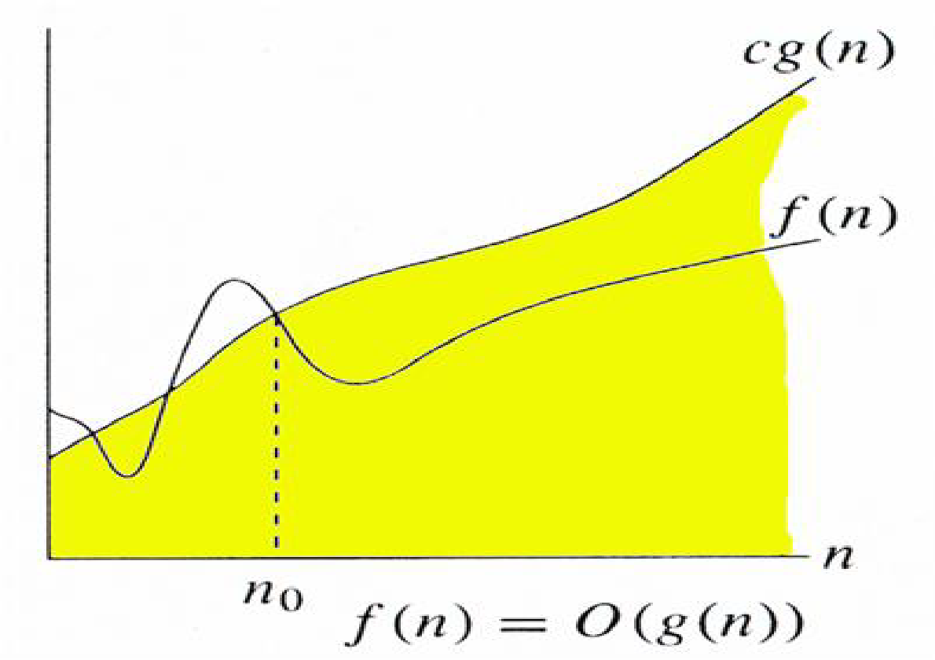
Big Oh Notation, Ο
It measures the worst case time complexity or longest amount of time an algorithm can possibly take to complete.
O(g(n)) = { f(n): there exist positive constants c and n0 such that
0 <= f(n) <= cg(n) for all n >= n0}

Slide 5
0 <= f(n) <= cg(n) for all n >= n0}
If f(n) = 3n+2
g(n)=n
Then
3n+2 <= cn
For instance c=4
3n+2<=4n
n>=2
Hence f(n) = O(g(n))
If f(n) = 3n+2 g(n)=n²
Then
3n+2 <= cn²
For instance c=1
n=1,2,3,4,5,6…
3n+2<=n²
n>=5
Hence f(n) = O(g(n))

Slide 6
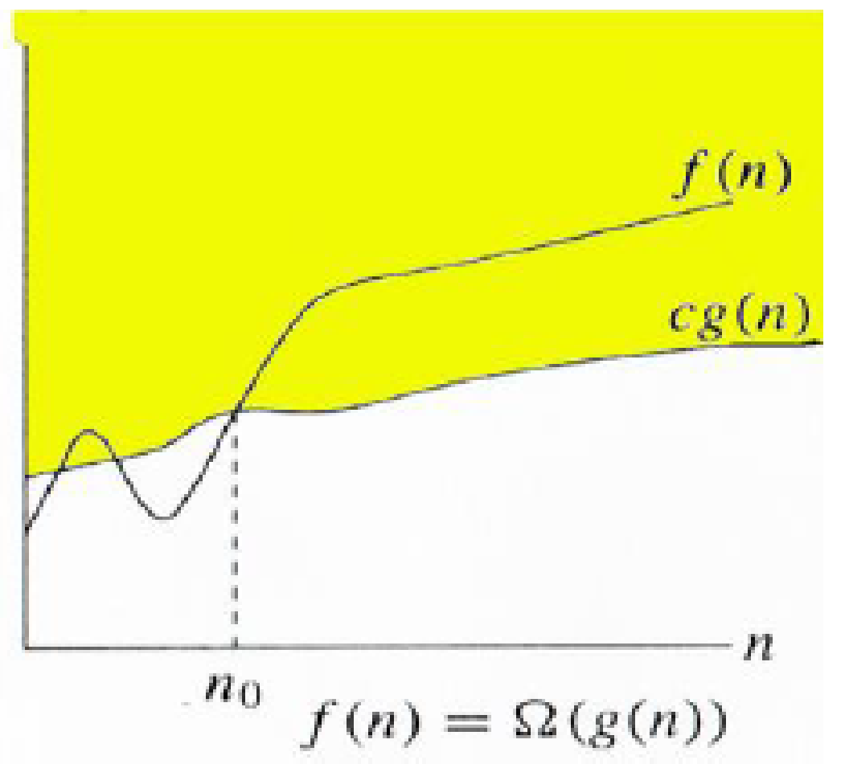
Ω Notation: (Best Case)
Ω notation provides an asymptotic lower bound

Slide 7
If f(n) = 3n+2
g(n)=n
Then
f(n)>= cg(n)
For instance c=1
3n+2 >= n
Hence f(n) = omega(g(n))
If f(n) = 3n+2 g(n)=n²
Then
3n+2 >= cn²
For instance c=1
n=1,2,3,4,5,6…
3n+2 >=n²
Hence f(n) = omega(n)
logn log(logn)

Slide 8
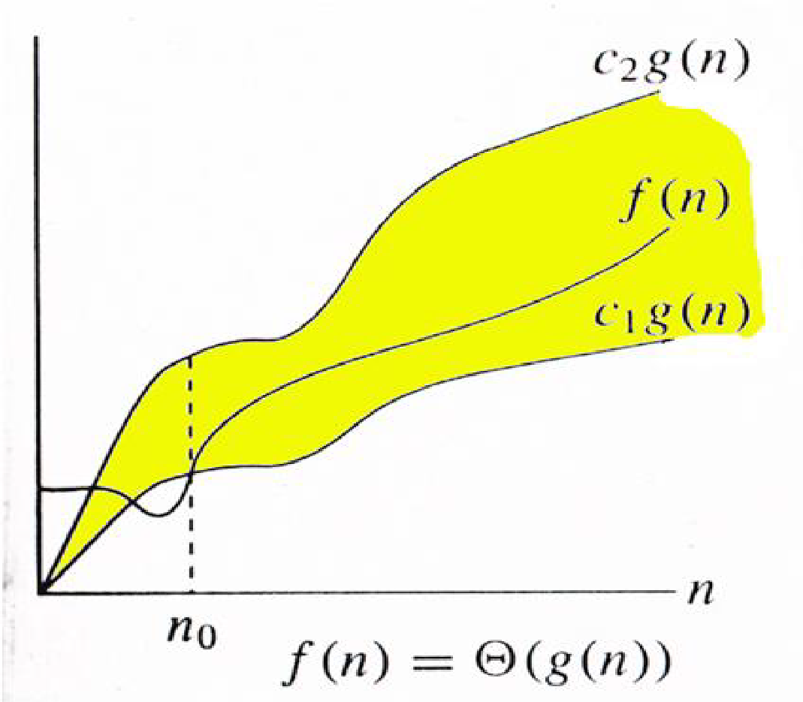
Θ Notation:
Θ((g(n)) = {f(n): there exist positive constants c1, c2 and n0 such that
0 <= c1*g(n) <= f(n) <= c2*g(n) for all n >= n0}

Slide 9
0 <= c1*g(n) <= f(n) <= c2*g(n) for all n >= n0}
If f(n) = 3n+2
g(n)=n
Then
c1*g(n) <= f(n) <= c2*g(n)
C1,c2>0 and N>n₀
For instance c2=4
f(n)<= c2g(n)
3n+2 <= 4n n₀₌₁
f(n)>= c1g(n)
For instance c1=1
3n+2 >= n
Hence f(n) = theta(n)

Slide 10
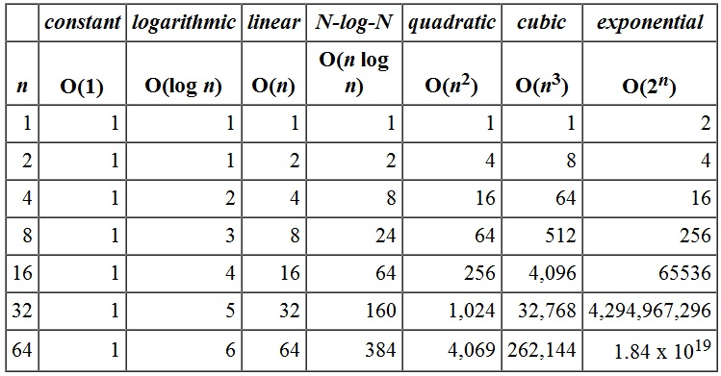
Order of Growth Function

Slide 11
